Slide 1

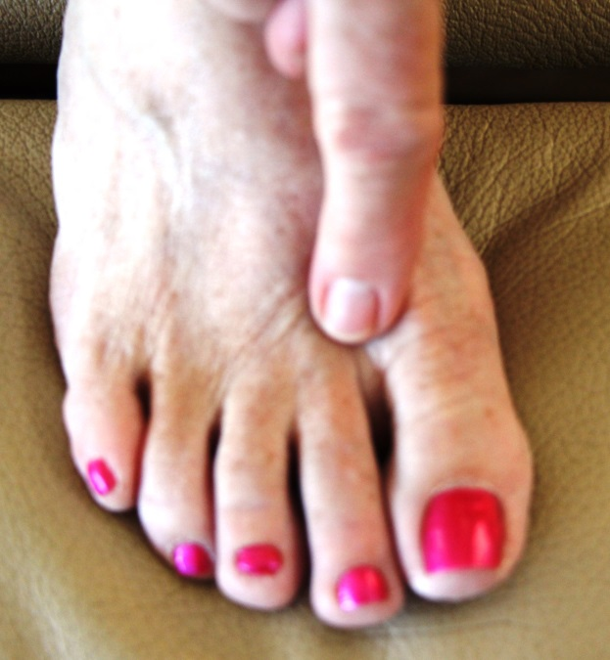
Hold both points at the same time as you repeat the trauma release statements
Trauma point on the right foot, hold with left hand fingers
Trauma Point on the forehead. Hold with right index finger

